Slide 1

Project Title: IoT-Based Smart Waste Management System for Smart University
Team Members:
Name
Sajia Bintea Jahangir
Tama Shil
Tanzila Akter
Class Roll
340
342
343

Slide 2

Table of Content
Abstract
Introduction
Materials
Circuit connection
Blynk Setup
Result and Discussion
Conclusion

Slide 3

Abstract
To make the waste disposal automated.
To control the waste disposal effectively
To monitor the waste level via a mobile app
Create an alert system for overloaded waste receptacle

Slide 4
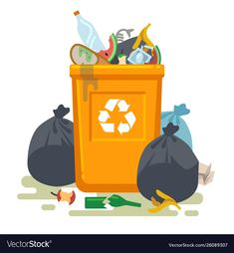
Introduction
Smart university requires smart and clean environment.
Cleanliness plays a pivotal role in creating an aesthetically pleasing atmosphere in smart university
Traditional waste management often fails to keep up the aesthetic of smart university.

Slide 5
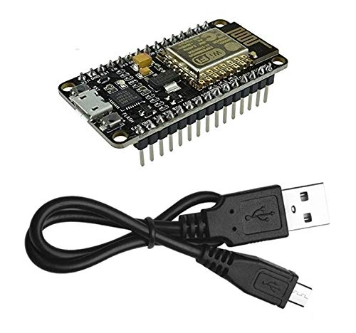
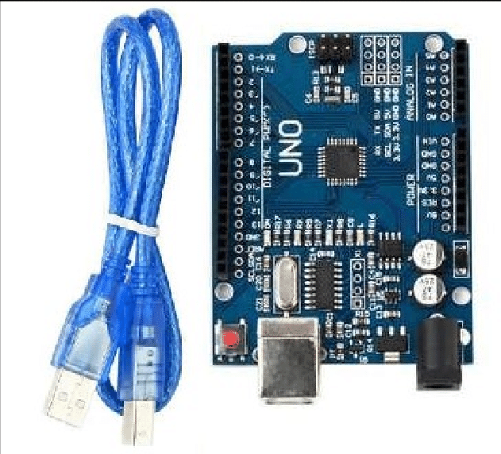
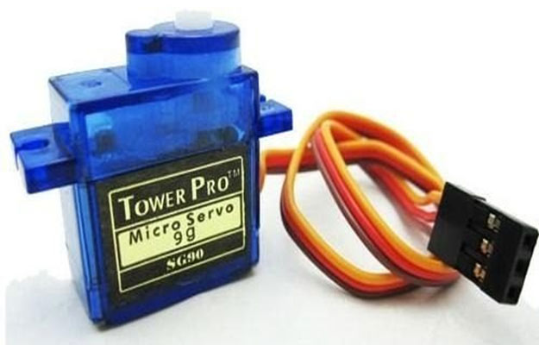
Materials
NodeMCU with USB micro cable
Arduino with USB 2.0 Cable Type A/B
Servo motor

Slide 6
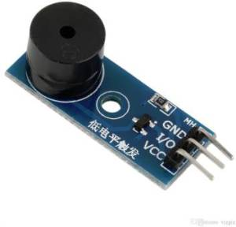
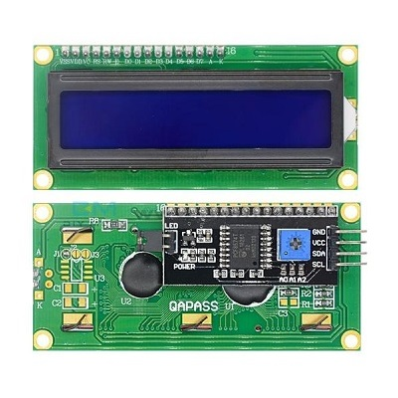
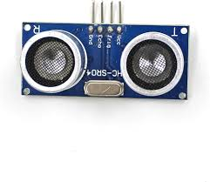
Materials
Buzzer
UltraSonic Sensor
LCD Display 16x2

Slide 7
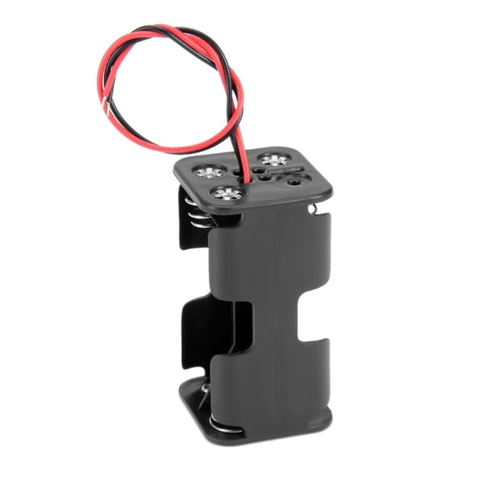
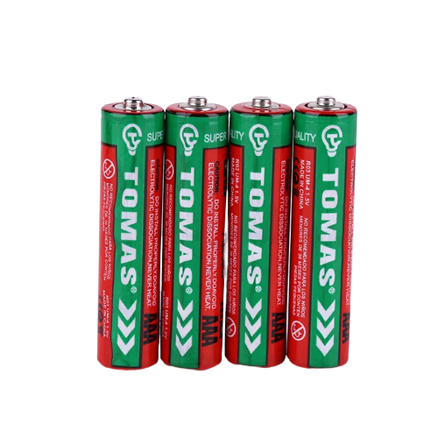
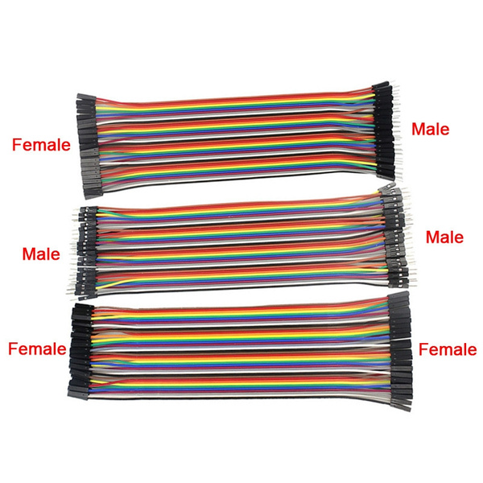
Materials
6V Battery with holder
Multiple types of wires( F-F, M-M, F-M)

Slide 8
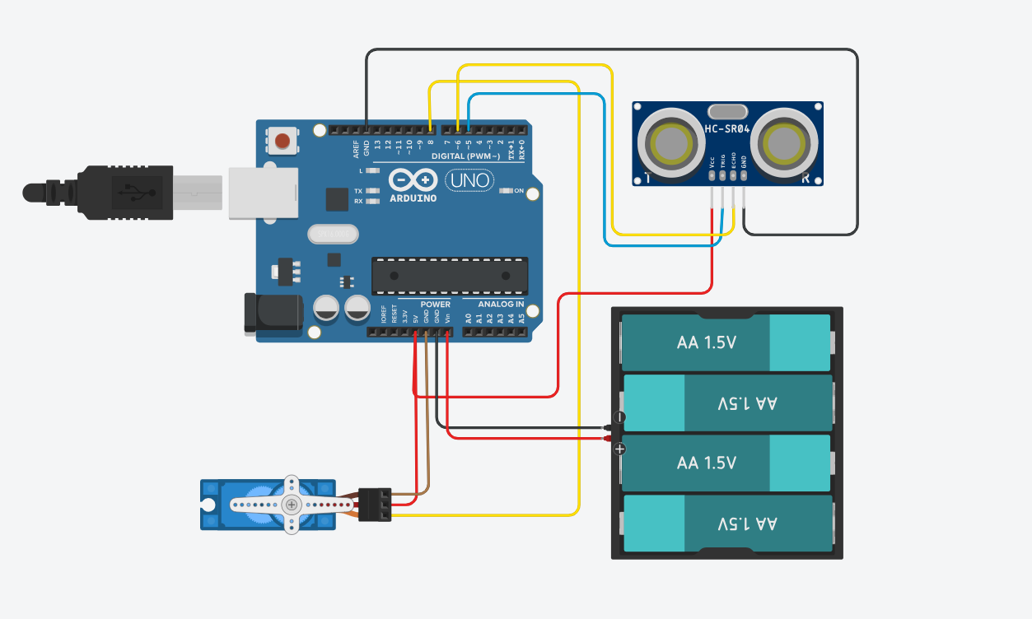
Materials Used
Circuit Diagram for Lid Open
Arduino
Ultrasonic sensor
Servo motor
6V power supply
USB 2.0 Cable Type A/B
An ultrasonic sensor is used to measure the distance of bin from objects.
Upon sensing the distance the sensor motor opens the lid of the dustbin
4 (1.5V) batteries are used together to provide 6V to the motor when the Arduino is not connected to laptop

Slide 9
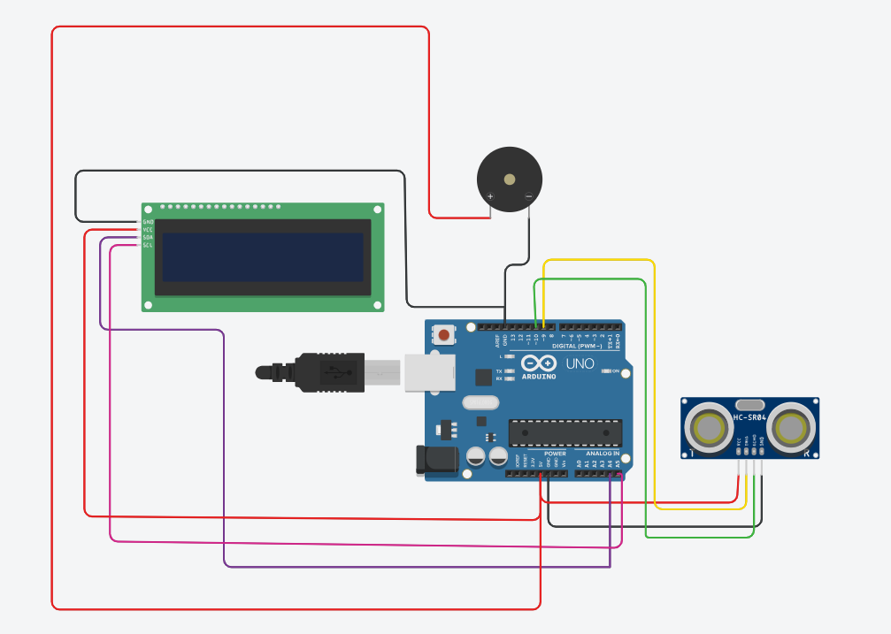

Materials Used
Circuit Diagram for Garbage Level
Arduino
Ultrasonic sensor
LCD display
Buzzer
USB 2.0 Cable Type A/B
The ultrasonic sensor measures the garbage level
The LCD display Shows the garbage level on its screen
When the garbage level is full The buzzer starts sounding until the garbage level is 0.

Slide 10
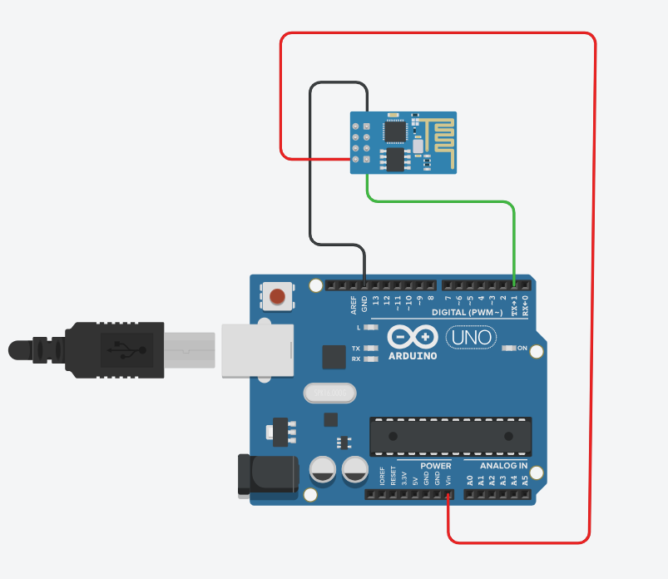
Materials Used
Circuit Diagram for Blynk Connection
Arduino
NodeMCU
USB micro cable
USB 2.0 Cable Type A/B
Connected The Arduino and NodeMCU to transfer data from Arduino to NodeMCU

Slide 11
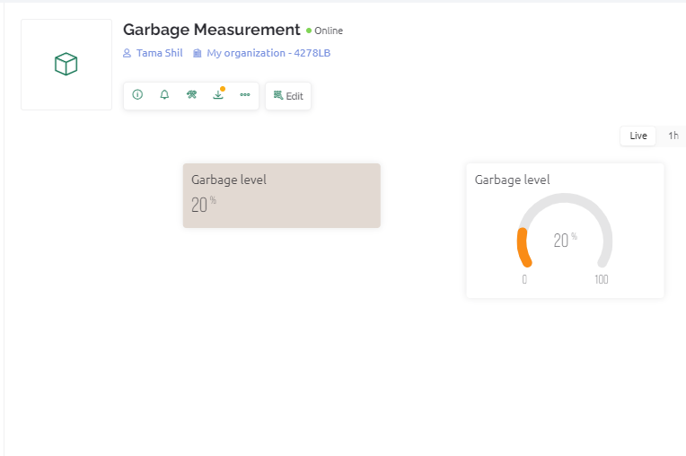

Blynk Setup
Created a device in Blynk IOT for monitoring Garbage level
The level for garbage level is denoted by 0-100%
The level changes automatically with the quantity of garbage in the bin.

Slide 12
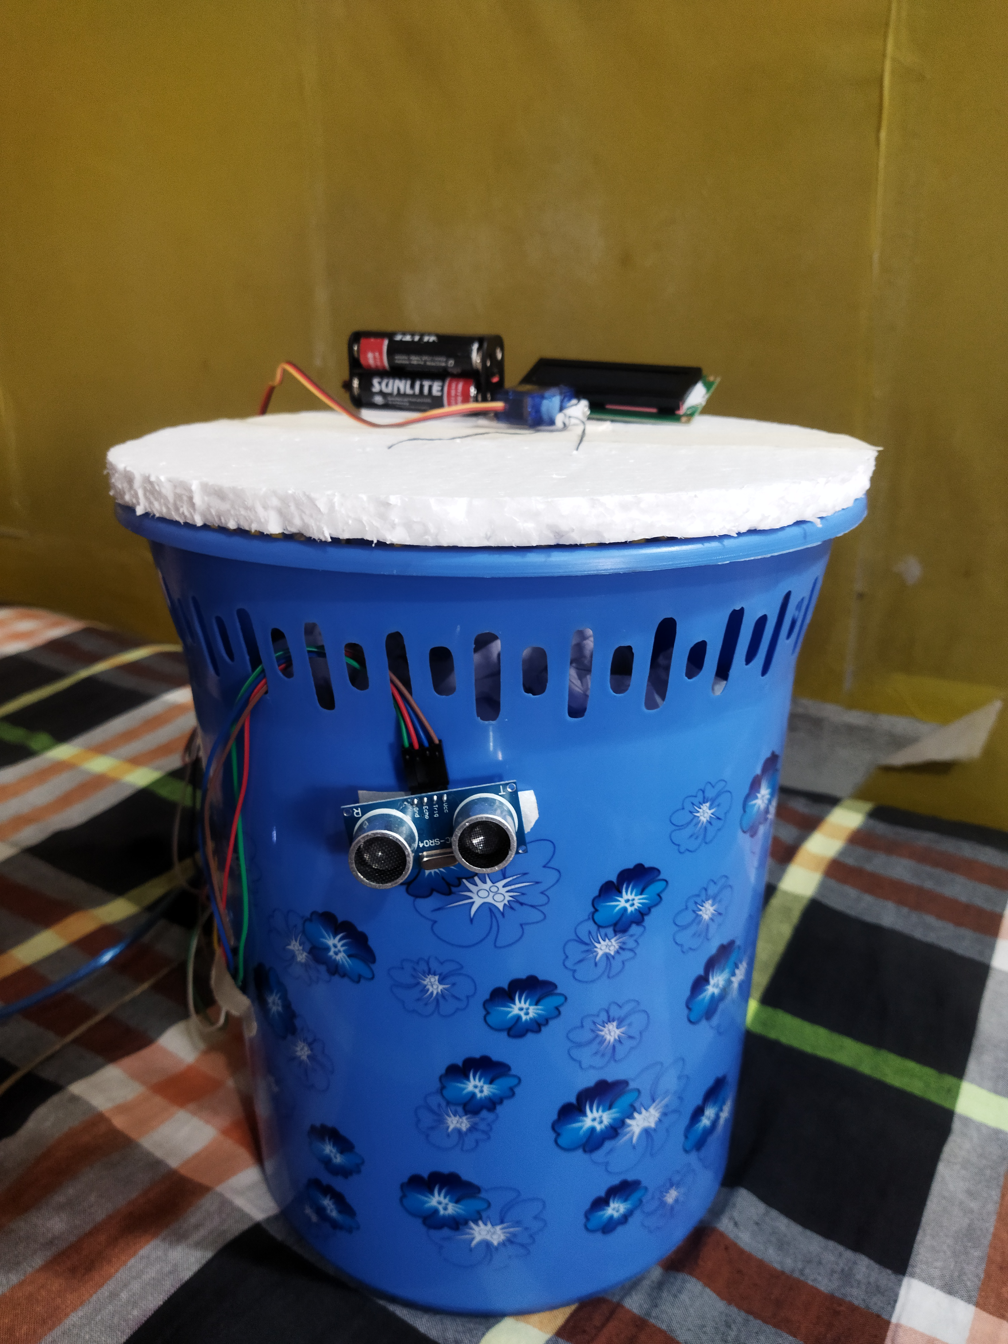
Result
and Discussion
First a sensor read the distance of obstacle and the motor opens the lid.
Then the LCD display shows the garbage level along with the blynk app.
When the garbage level reaches 100% then the buzzer starts buzzing and the servo motor stops opening the lid.

Slide 13
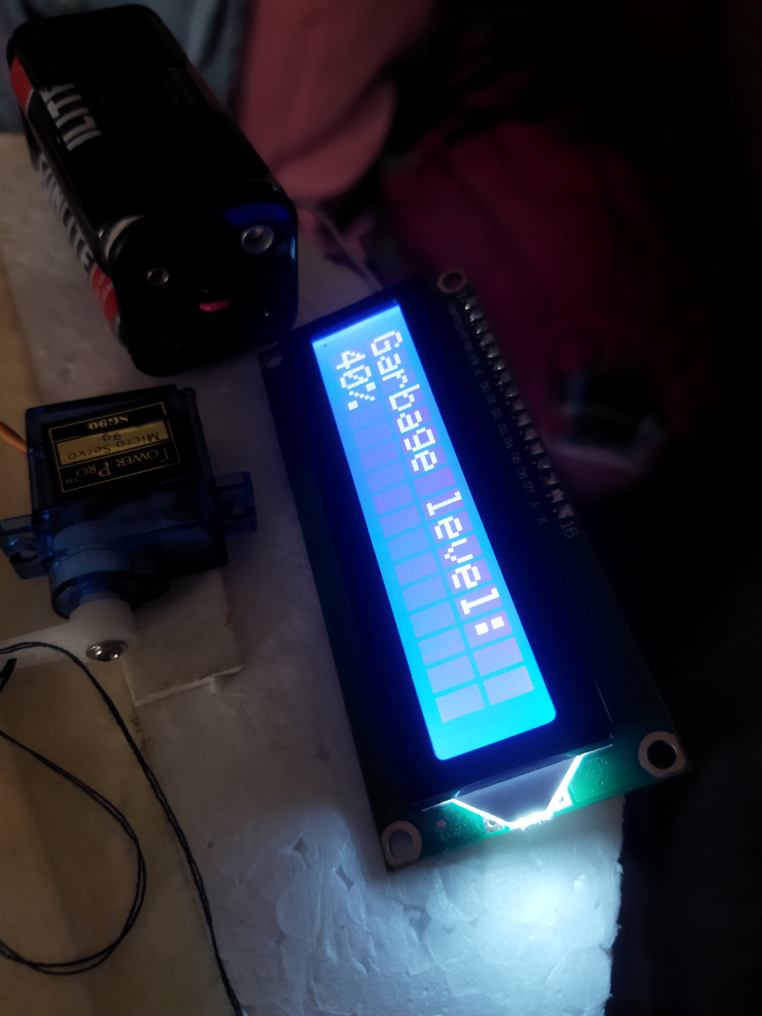
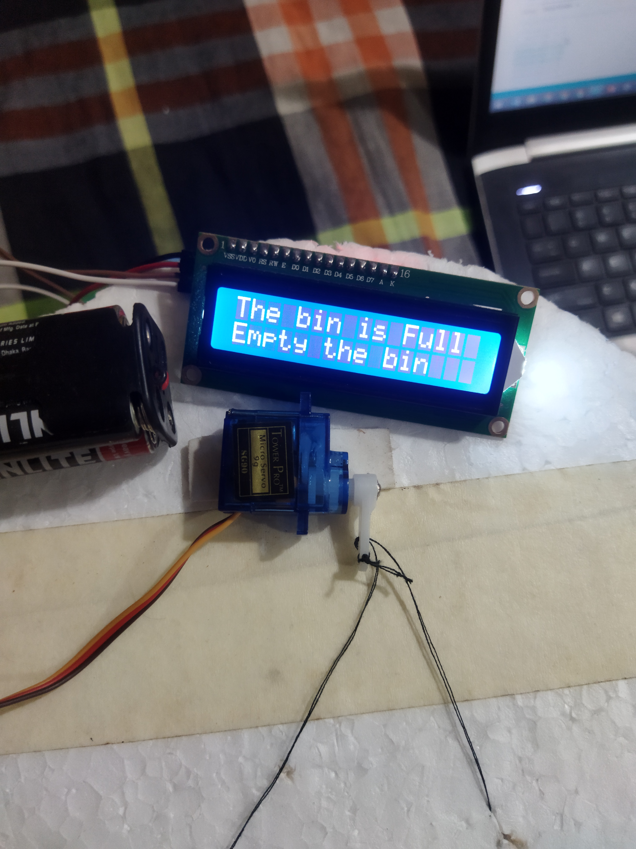
Result
and Discussion

Slide 14

Conclusion
Automated lid opening and real-time waste level monitoring streamline waste management.
System promotes cleanliness and sustainability on campus.
Real-time data accessible through LCD display and Blynk app for easy monitoring.
Ensures timely waste removal and prevents overflow, maintaining campus aesthetics.

